Slide 1
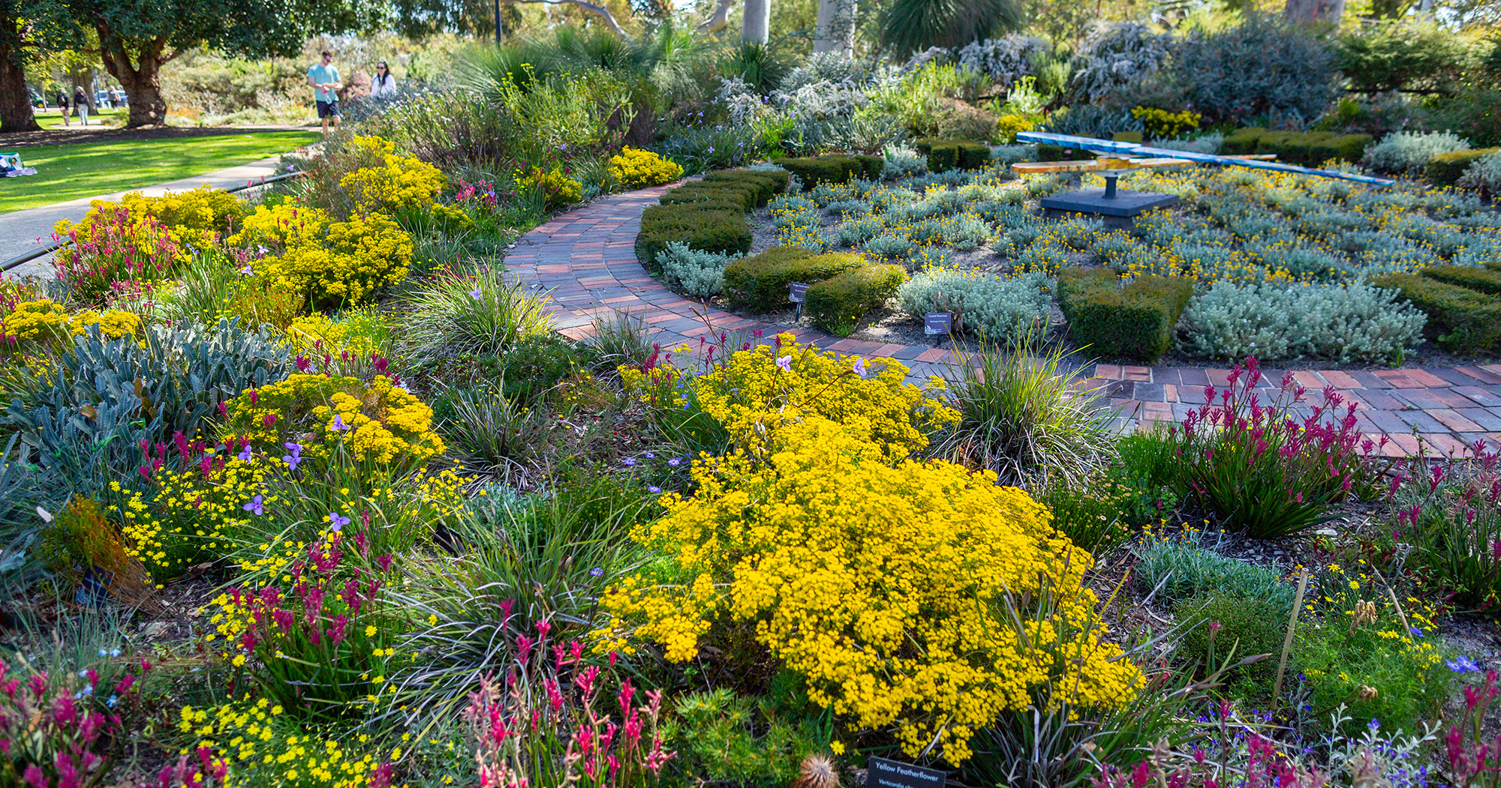

SUNDAY 26 MAY 2024
www.bganz.org.au
#BotanicGardensDay
#BotanicGardensDay2024
#MoreThanAGarden2024
Image: Jason Thomas, Kings Park & Botanic Garden

Slide 2
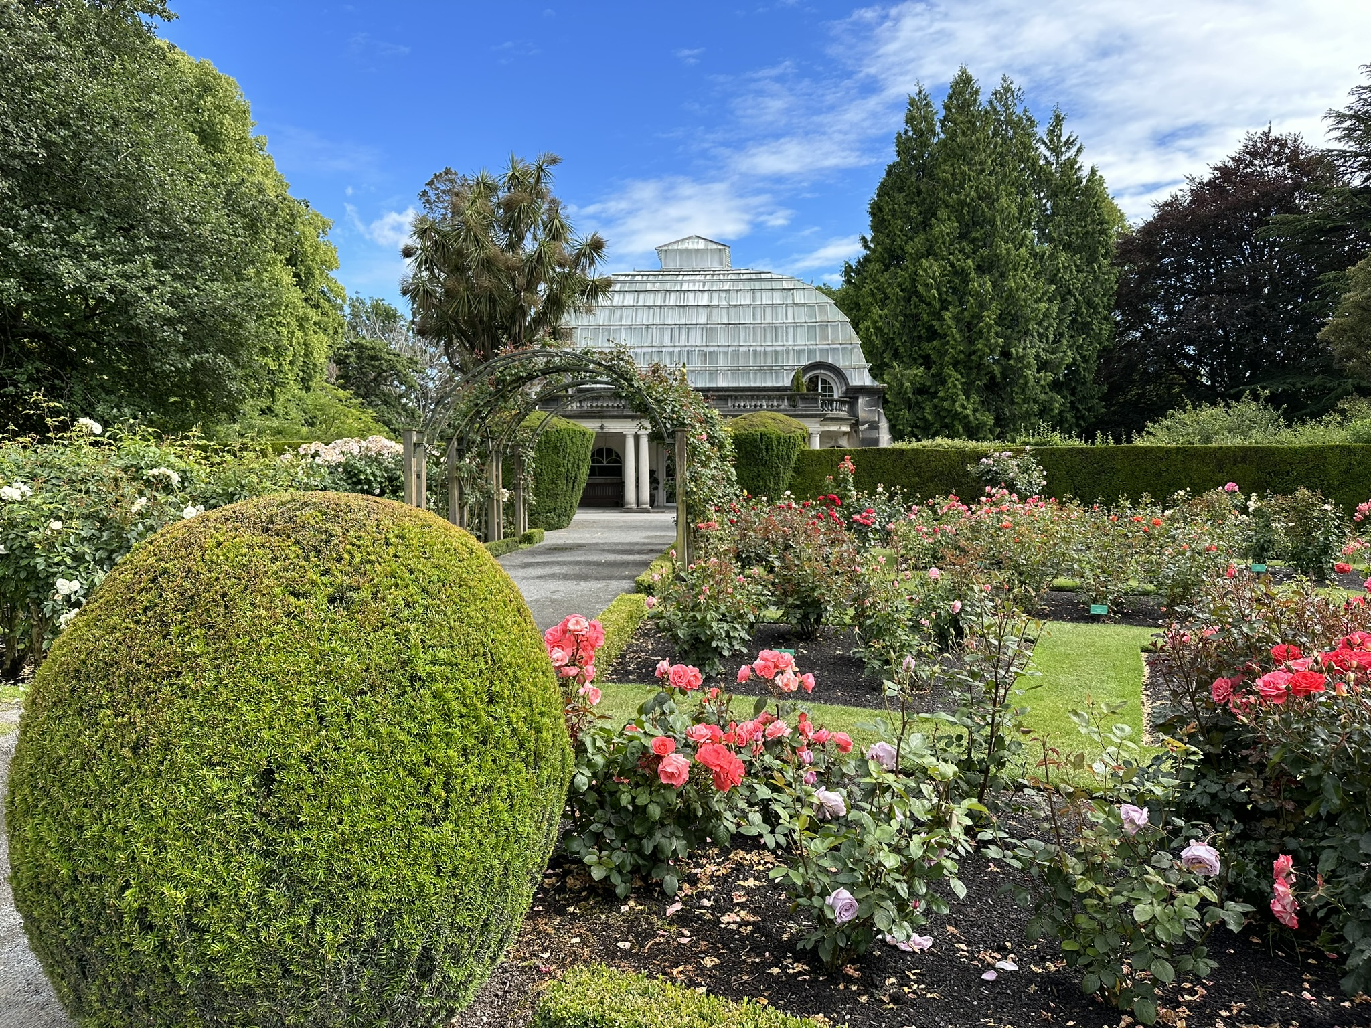
SUNDAY 26 MAY 2024
#BotanicGardensDay
#BotanicGardensDay2024
#MoreThanAGarden2024
www.bganz.org.au
Image: Christchurch Botanic Gardens. Credit Rebecca Harcourt

Slide 3
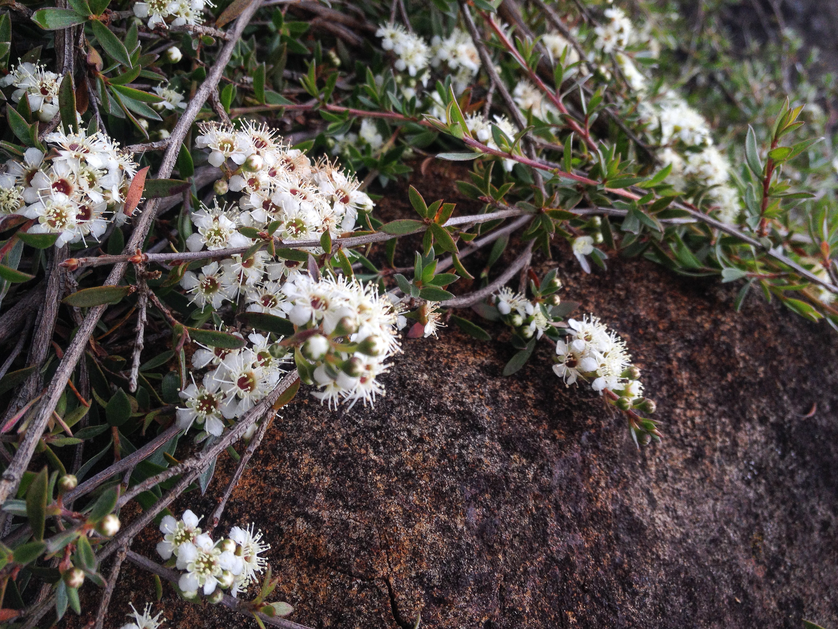
SUNDAY 26 MAY 2024
#BotanicGardensDay
#BotanicGardensDay2024
#MoreThanAGarden2024
Kunzea sinclairii
www.bganz.org.au
Image: Auckland Botanic Gardens. Credit Emma Simpkins

Slide 4

Heading text
Subheading text
www.bganz.org.au
Click icon to add an image, it will crop to the placeholder size, to reposition or enlarge, select the picture, go to Format > Crop to edit the image within the frame.
To change the image, click on the frame and delete which will bring up the placeholder frame again.
You will need to put the image behind the footer, select, right click, select Send to Back.
SUNDAY 26 MAY 2024
#BotanicGardensDay
#BotanicGardensDay2024
#MoreThanAGarden2024
Image: XXX

Slide 5
www.bganz.org.au
Click icon to add an image, it will crop to the placeholder size, to reposition or enlarge, select the picture, go to Format > Crop to edit the image within the frame.
To change the image, click on the frame and delete which will bring up the placeholder frame again.
You will need to put the image behind the footer, select, right click, select Send to Back.
SUNDAY 26 MAY 2024
#BotanicGardensDay
#BotanicGardensDay2024
#MoreThanAGarden2024

Slide 6
Heading text
Subheading text
www.bganz.org.au
Click icon to add an image, it will crop to the placeholder size, to reposition or enlarge, select the picture, go to Format > Crop to edit the image within the frame.
To change the image, click on the frame and delete which will bring up the placeholder frame again.
You will need to put the image behind the footer, select, right click, select Send to Back.
SUNDAY 26 MAY 2024
#BotanicGardensDay
#BotanicGardensDay2024
#MoreThanAGarden2024
Image: XXX

Slide 7
Heading text
Subheading text
www.bganz.org.au
Click icon to add an image, it will crop to the placeholder size, to reposition or enlarge, select the picture, go to Format > Crop to edit the image within the frame.
To change the image, click on the frame and delete which will bring up the placeholder frame again.
You will need to put the image behind the footer, select, right click, select Send to Back.
SUNDAY 26 MAY 2024
#BotanicGardensDay
#BotanicGardensDay2024
#MoreThanAGarden2024
Image: XXX

Slide 8
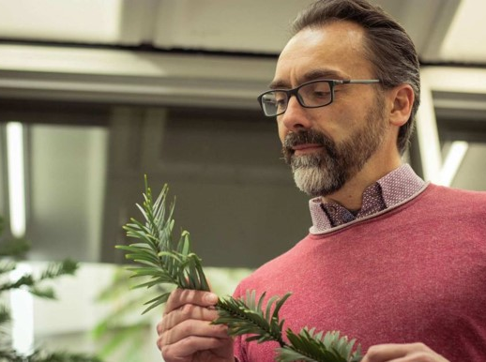
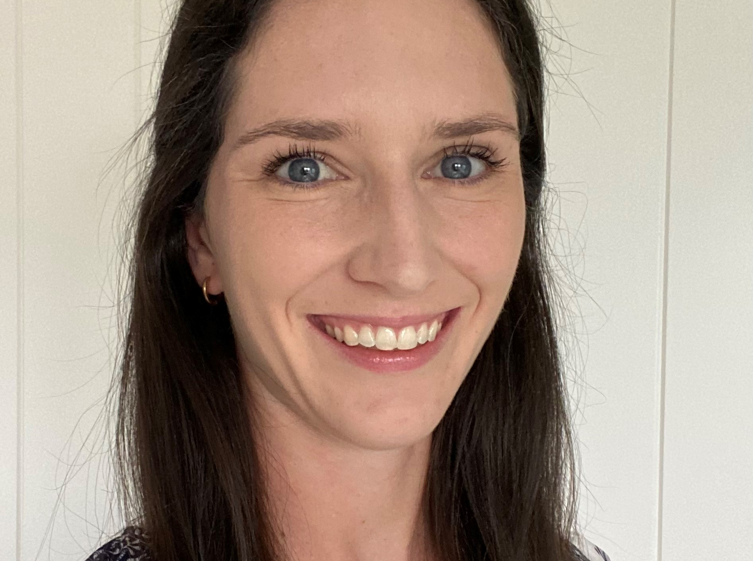
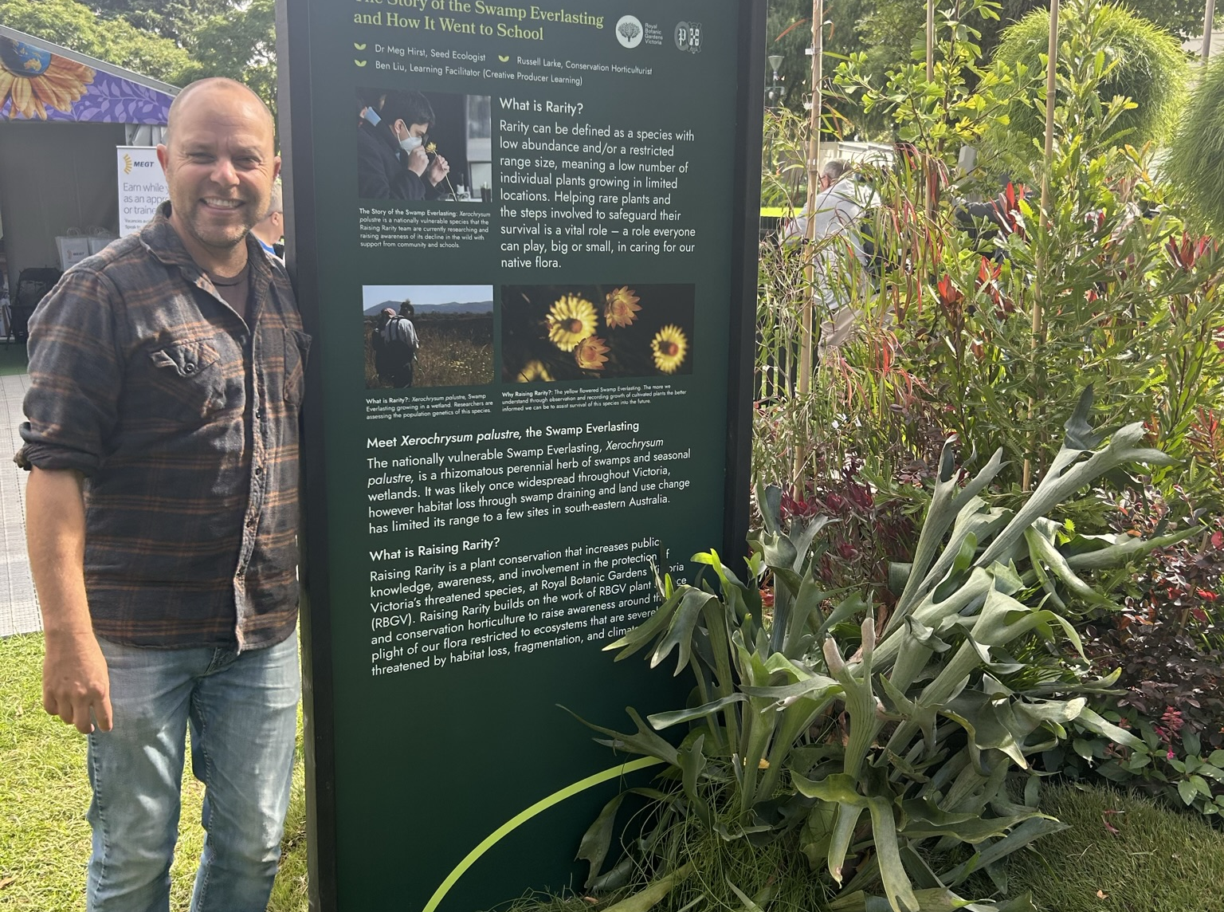
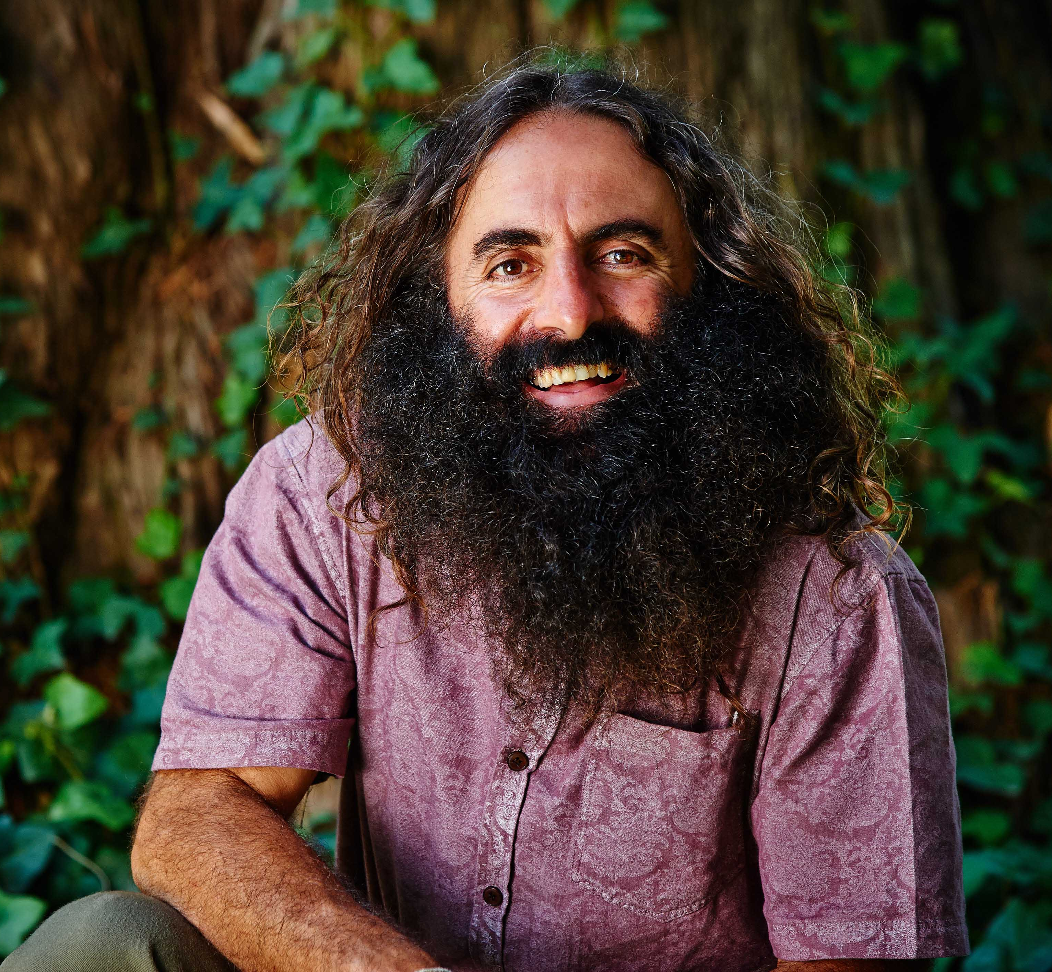

Join Costa Georgiadis as he hosts our first Botanic Gardens Webinar 2024 featuring…
Click icon to add an image, it will crop to the placeholder size, to reposition or enlarge, select the picture, go to Format > Crop to edit the image within the frame.
To change the image, click on the frame and delete which will bring up the placeholder frame again.
You will need to put the image behind the footer, select, right click, select Send to Back.
Maurizio Rossetto
Research Centre of Ecosystem Resilience
Royal Botanic Garden Sydney
Emma Simpkins
Senior Regional Advisor Flora
Auckland Council
Russell Larke
Senior Curator
Royal Botanic Gardens Victoria (Cranbourne Gardens)
Join via Costa’s Facebook or YouTube pages
Botanic Gardens Webinar Series 2024
Science Saving Species
Webinar 1 – 2 May 2024 – 7pm AEST
www.bganz.org.au
SUNDAY 26 MAY 2024
#BotanicGardensDay
#BotanicGardensDay2024
#MoreThanAGarden2024

